Slide 1
Introduction to React
Lecturer: Ngo Huy Bien
Software Engineering Department
Faculty of Information Technology
VNUHCM - University of Science
Ho Chi Minh City, Vietnam
nhbien@fit.hcmus.edu.vn

Slide 2

Objectives

Slide 3

Contents

Slide 4

References
Kirupa Chinnathambi (2018). Learning React: A Hands-On Guide to Building Web Applications Using React and Redux. Addison-Wesley Professional.

Slide 5
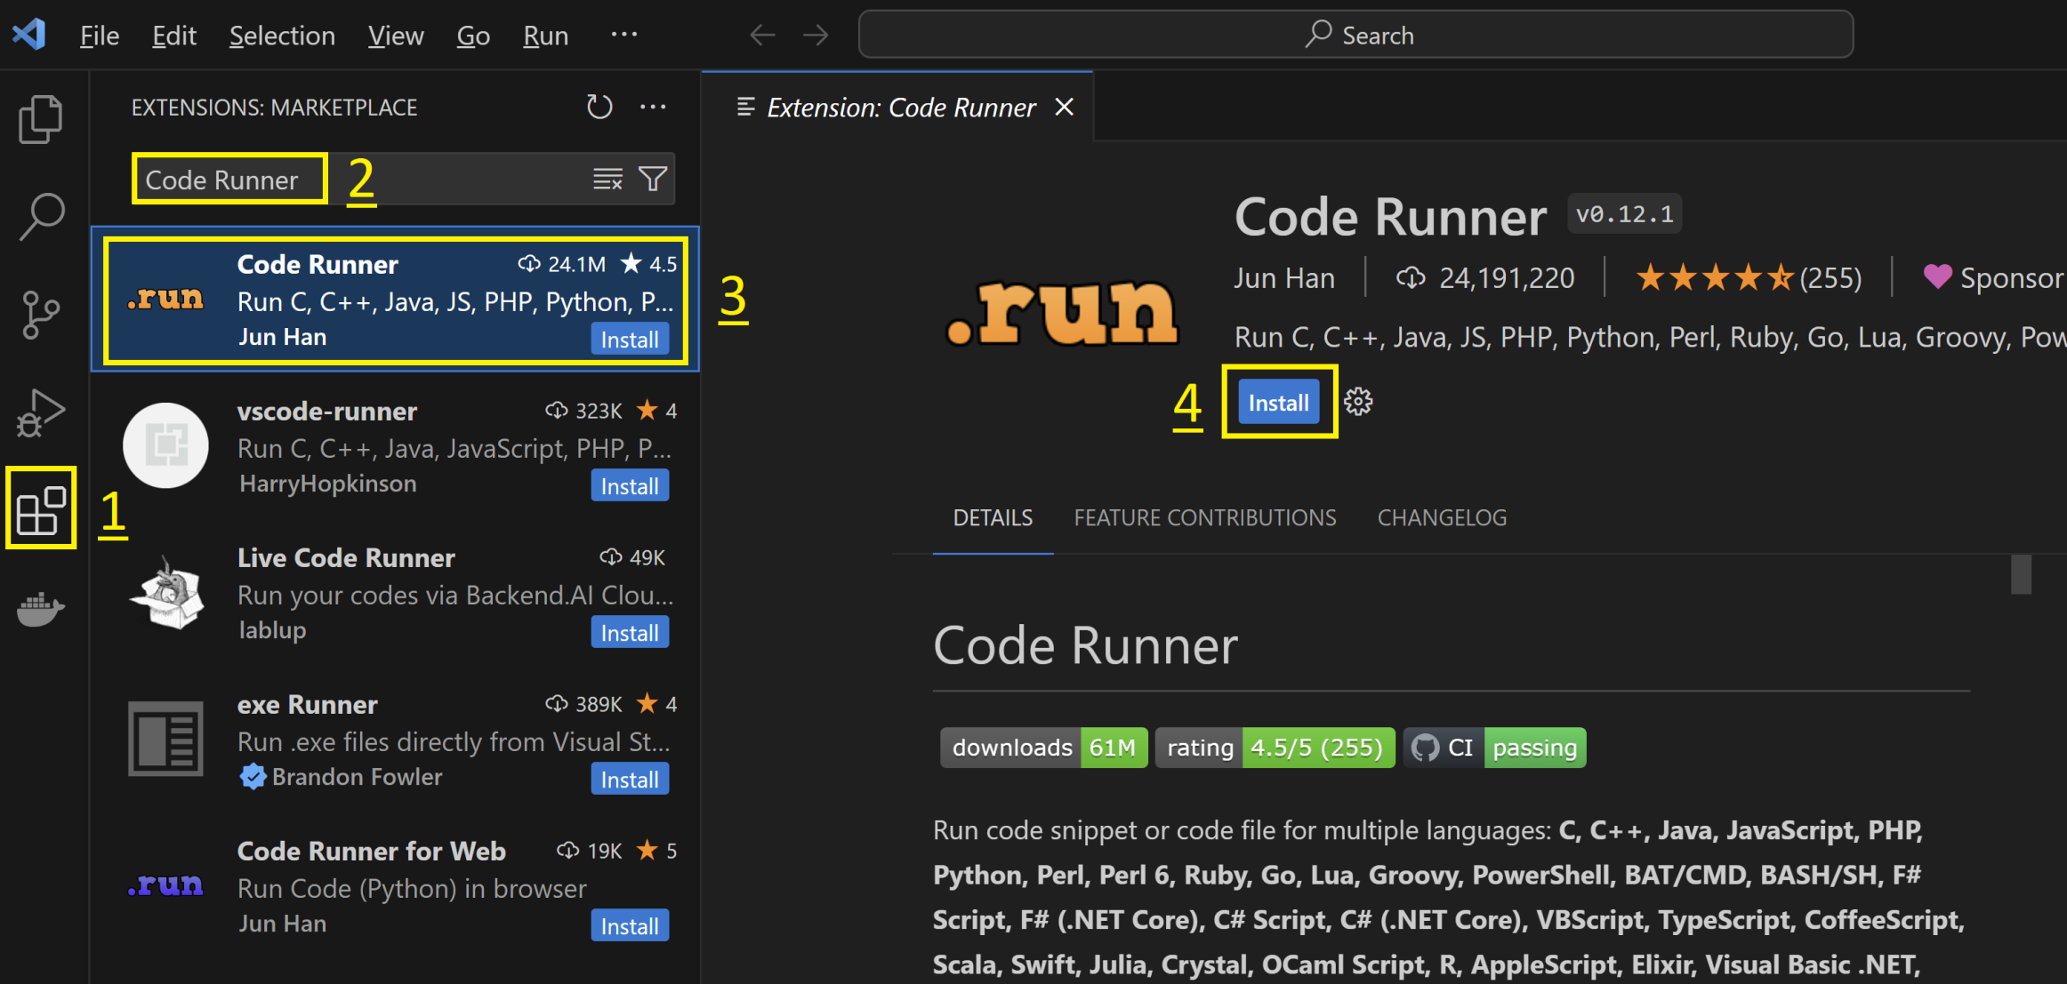
1. Install Code Runner

Slide 6
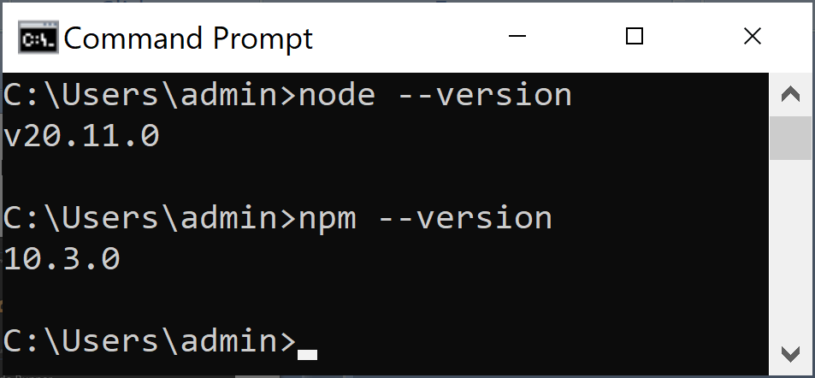
2. Install Node.js

Slide 7
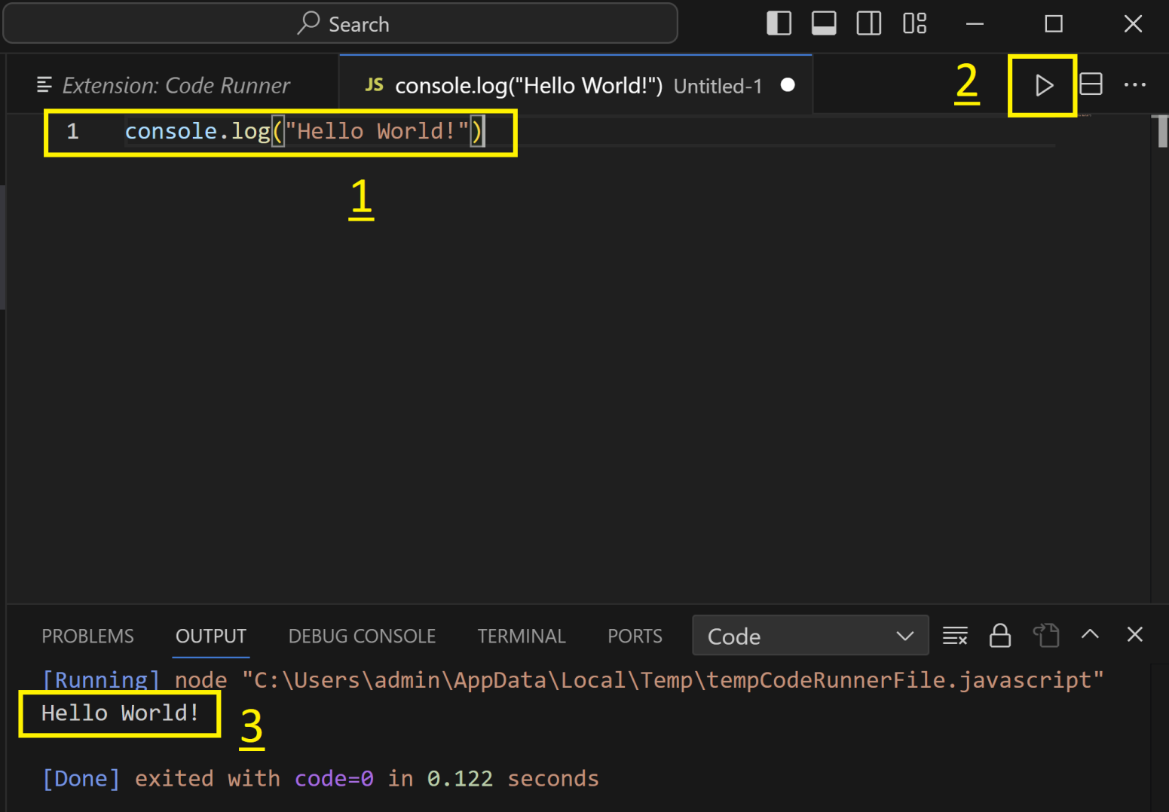
3. Run JavaScript Code

Slide 8
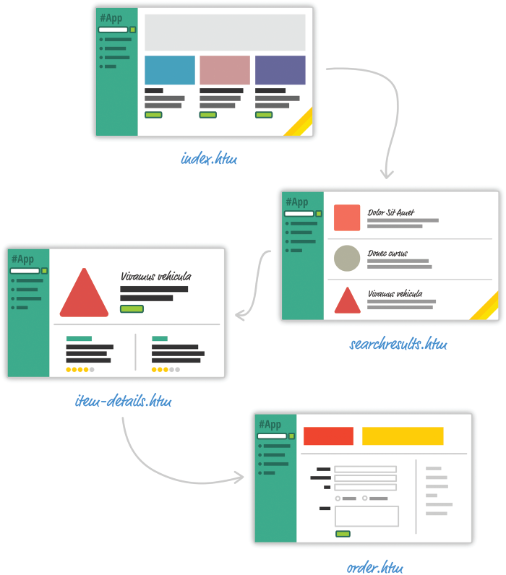
Multi-Page Design [1]
For almost every action that changes what the browser displays, the web app will navigate you to a whole different page.
This is a big deal beyond the less-than-stellar user experience that users will see as pages get torn down and redrawn.
This has a big impact on how you maintain your app state.
Outside of storing some user data via cookies and some server-side mechanism, you simply don't need to care.

Slide 9
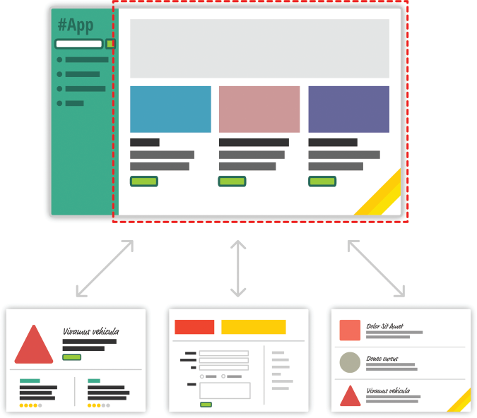
Single-Page App
As users interact with our app, we replace the contents of the dotted red region with the data and HTML that matches what the user is trying to do.
The end result is a much more fluid experience.

Slide 10
Data and UI Synchronization
In a single-page application, the bulk of your time will be spent keeping your data in sync with your UI.
For example, if a user loads new content, do we explicitly clear out the search field? Do we keep the active tab on a navigation element still visible? Which elements do we keep on the page, and which do we destroy?
These are all problems unique to single-page apps.
When navigating between pages in the old model, we just assumed everything in our UI would be destroyed and just built back up again. This was never a problem.

Slide 11
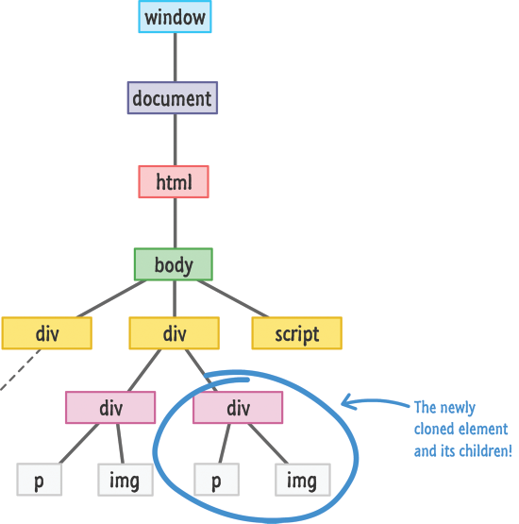
DOM Manipulation Speed
One way to keep data in sync with UI is to manipulate the DOM.
Manipulating the DOM is really REALLY slow.
Manually querying elements, adding children, removing subtrees, and performing other DOM operations are some of the slowest things you can do in your browser.

Slide 12
Working with HTML Templates
Navigation in a single-page app is nothing more than you dealing with fragments of HTML to represent whatever it is you wish to display.
These fragments of HTML are often known as templates, and using JavaScript to manipulate them and fill them out with data gets really complicated really quickly.
For example, this is what using a template in Mustache looks like:
var view = {
title: "Joe",
calc: function () {
return 2 + 4;
}
};
var output = Mustache.render("{{title}} spends {{calc}}", view);

Slide 13

One of Solutions: React
Despite these shortcomings, single-page apps aren't going anywhere.
They are a part of the present, and they will fully form the future of how web apps are built.
That doesn't mean that we have to tolerate these shortcomings.
To address this, meet React!

Slide 14
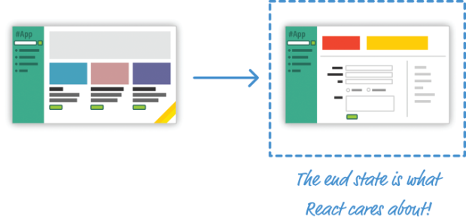
Automatic UI State Management
With single-page apps, keeping track of your UI and maintaining state is hard—and very time-consuming.
With React, you need to worry only about one thing: the final state your UI is in.
It doesn't matter what state your UI started out in.
It doesn't matter what series of steps your users may have taken to change the UI.
All that matters is where your UI ended up.

Slide 15
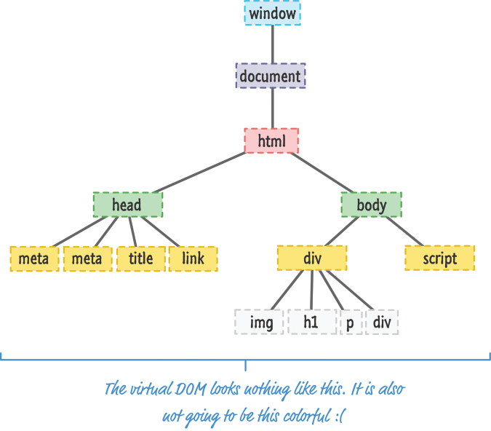
Lightning-Fast DOM Manipulation
Because DOM modifications are really slow, you never modify the DOM directly using React.
Instead, you modify an in-memory virtual DOM instead.
React takes care of updating the real DOM when the time is right. It does so by comparing the changes between your virtual DOM and the real DOM, figuring out which changes actually matter, and making the least amount of DOM changes needed to keep everything up-to-date in a process called reconciliation.

Slide 16
APIs to Create Truly Composable UIs
Instead of treating the visual elements in your app as one monolithic chunk, React encourages you to break your visual elements into smaller and smaller components.
Just like everything else in programming, it is a good idea to have things be modular, compact, and self-contained.
Many of React's core APIs make it easier to create smaller visual components that can later be combined with other visual components to make larger and more complex visual components

Slide 17
JSX (JavaScript eXtension)
It doesn't matter if your web app was written using React or some other library like Angular, Knockout, or jQuery.
The end result has to be some combination of HTML, CSS, and JavaScript.
Otherwise, your browser really won't know what to do.
Besides normal HTML, CSS, and JavaScript, the bulk of your React code will be written in something known as JSX (JavaScript eXtension).
JSX is a language that allows you to easily mix JavaScript and HTML-like tags to define user interface (UI) elements and their functionality.
To build a web app using React, we need a way to take our JSX and convert it into plain old JavaScript that your browser can understand.

Slide 18


Slide 19
What You Need
Visual Studio Code. https://code.visualstudio.com/

Slide 20

1. Create Hello World
<!DOCTYPE html>
<html>
<head>
<title>React! React! React!</title>
<title>React! React! React!</title>
<script src="https://unpkg.com/react@16/umd/react.development.js"></script>
<script src="https://unpkg.com/react-dom@16/umd/react-dom.development.js"></script>
<script src="https://unpkg.com/babel-standalone@6.15.0/babel.min.js"></script>
</head>
<body>
<script type="text/babel">
ReactDOM.render(
<h1>Hello World!</h1>,
document.body
);
</script>
</body>
</html>
Use the Babel library to translate the JSX into JavaScript on the browser itself.

Slide 21

2. Use a DIV
<body>
<div id="container"></div>
<script type="text/babel">
var destination = document.querySelector("#container");
ReactDOM.render(React.createElement(
"h1",
null,
"Hello World!"
),
destination
);
</script>
</body>

Slide 22
ReactDOM.render
<body>
<div id="container"></div>
<script type="text/babel">
var destination = document.querySelector("#container");
ReactDOM.render(
<div>
<h1>Batman</h1>
<h1>Iron Man</h1>
<h1>Nicolas Cage</h1>
<h1>Mega Man</h1>
</div>,
destination
);
</script>
</body>

Slide 23
React.createElement
<body>
<div id="container"></div>
<script type="text/babel">
var destination = document.querySelector("#container");
ReactDOM.render(React.createElement(
"div",
null,
React.createElement(
"h1", null, "Batman"
),
React.createElement(
"h1", null, "Iron Man"
),
React.createElement(
"h1", null, "Nicolas Cage"
),
React.createElement(
"h1", null, "Mega Man"
)
), destination);
</script>
</body>

Slide 24
JSX & External JavaScript Library
Let your browser rely on a JavaScript library to automatically convert JSX to something it understands.
You specify your JSX directly just like you would any old piece of JavaScript, and your browser takes care of the rest.
To use this solution, all you do is reference a script file.

Slide 25
JSX & Built-Tools
Set up a development environment around Node and a handful of build-tools.
In this environment, every time you perform a build, all of your JSX is automatically converted into JS and placed on disk for you to reference like any plain JavaScript file.

Slide 27
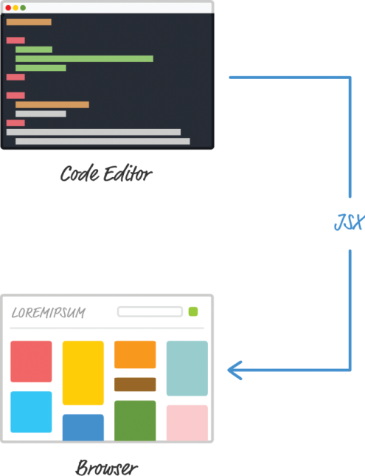
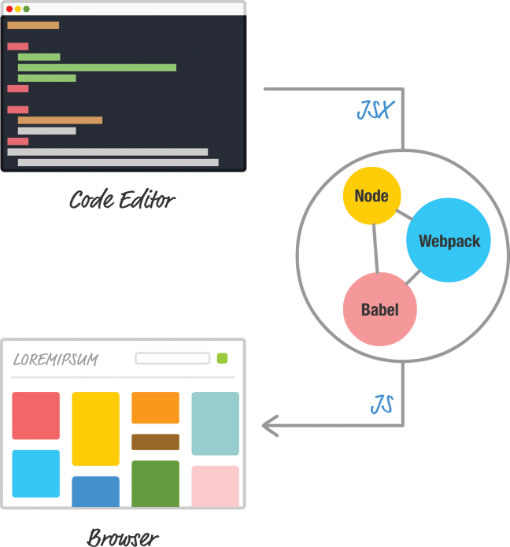
React Development Environment
Browser is responsible for turning your JSX into actual JavaScript.
The downside is performance.
JSX to JS conversion is handled prior to the user loading the page.

Slide 28
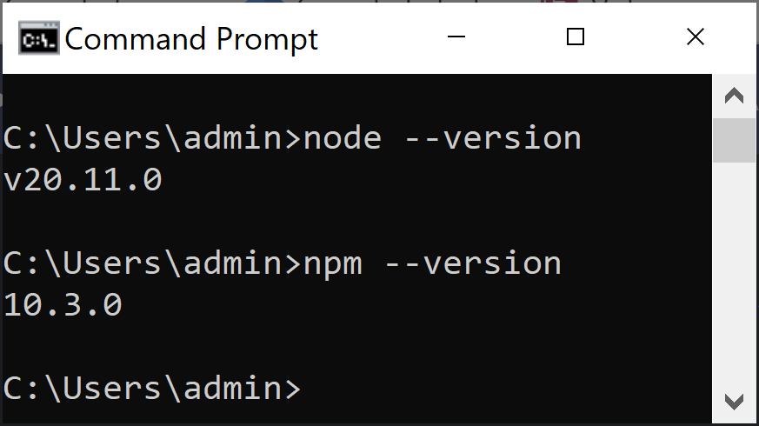
1. Install Nodejs
https://nodejs.org/en/

Slide 29
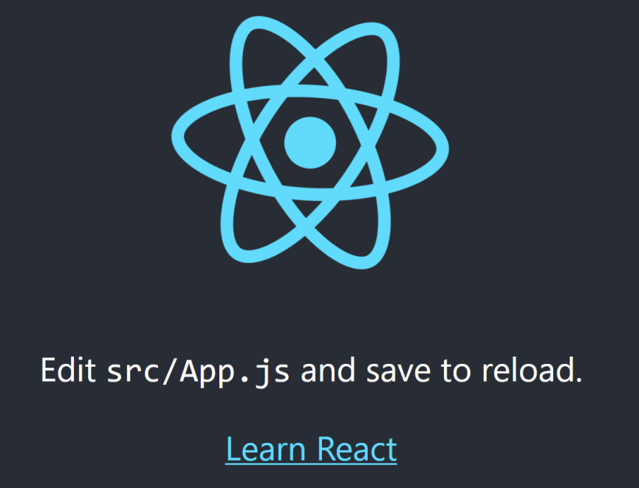
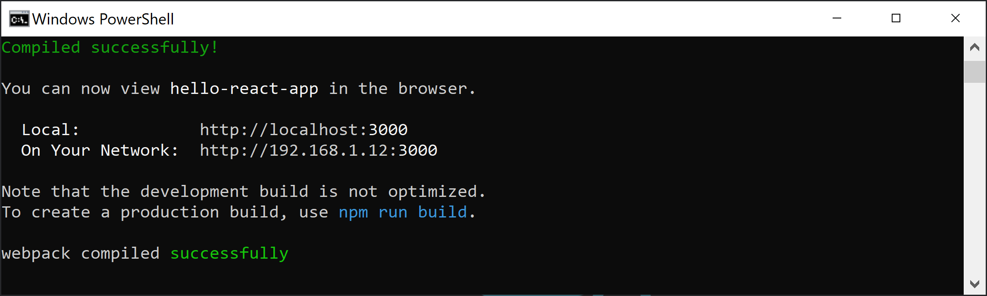
2. Create and Run React App
npm init react-app hello-react-app
cd hello-react-app
npm start

Slide 30
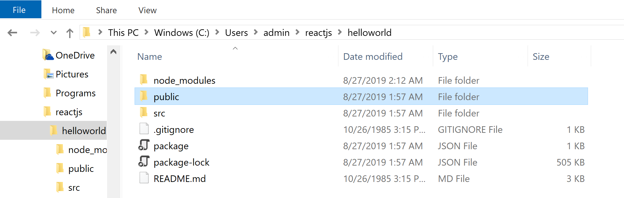
3. Review Application Structure

Slide 31
index.html
...
<link rel="manifest" href="%PUBLIC_URL%/manifest.json" />
<!--
Notice the use of %PUBLIC_URL% in the tags above.
It will be replaced with the URL of the `public` folder during the build.
Only files inside the `public` folder can be referenced from the HTML.
Unlike "/favicon.ico" or "favicon.ico", "%PUBLIC_URL%/favicon.ico" will
work correctly both with client-side routing and a non-root public URL.
Learn how to configure a non-root public URL by running `npm run build`.
-->
<title>React App</title>
</head>
<body>
<noscript>You need to enable JavaScript to run this app.</noscript>
<div id="root"></div>
<!--
This HTML file is a template.
If you open it directly in the browser, you will see an empty page.
You can add webfonts, meta tags, or analytics to this file.
The build step will place the bundled scripts into the <body> tag.
To begin the development, run `npm start` or `yarn start`.
To create a production bundle, use `npm run build` or `yarn build`.
-->
</body>
</html>

Slide 32
index.js
import React from 'react';
import ReactDOM from 'react-dom';
import './index.css';
import App from './App';
import * as serviceWorker from './serviceWorker';
ReactDOM.render(<App />, document.getElementById('root'));
// If you want your app to work offline and load faster, you can change
// unregister() to register() below. Note this comes with some pitfalls.
// Learn more about service workers: https://bit.ly/CRA-PWA
serviceWorker.unregister();

Slide 33
App.js
import React from 'react';
import logo from './logo.svg';
import './App.css';
function App() {
return (
<div className="App">
<header className="App-header">
<img src={logo} className="App-logo" alt="logo" />
<p>
Edit <code>src/App.js</code> and save to reload.
</p>
<a
className="App-link"
href="https://reactjs.org"
target="_blank"
rel="noopener noreferrer"
>
Learn React
</a>
</header>
</div>
);
}
export default App;

Slide 34

Hello World!
/* HelloWorld.js */
import React, { Component } from 'react';
import './HelloWorld.css';
class HelloWorld extends Component {
render() {
return (
<div className="helloContainer">
<h1>Hello, world!</h1>
</div>
);
}
}
export default HelloWorld;
/* index.js */
import React from 'react';
import ReactDOM from 'react-dom';
import './index.css';
import App from './App';
import * as serviceWorker from './serviceWorker';
import HelloWorld from './HelloWorld';
ReactDOM.render(<HelloWorld />, document.getElementById('root'));
...

Slide 35

Thank You & See You Again

